Slide 1


INSTITUTE : UIE
DEPARTMENT : CSE
Bachelor of Engineering (Computer Science & Engineering)
WEB AND MOBILE SECURITY (Professional Elective-I)
(20CST/IT-333)
TOPIC OF PRESENTATION:
Client-side scripting, Server-side scripting.
DISCOVER . LEARN . EMPOWER

Slide 2
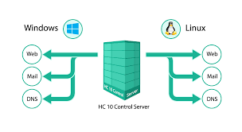
Lecture Objectives
In this lecture, we will discuss:
Introduction to Web server architecture .
Windows vs Linux

Slide 3
INTRODUCTION TO WEB SERVER
‹#›
Web server
Specialized software that responds to client requests by providing resources
When users enter URL into Web browsers, they request specific documents from Web server
Maps URL to file on server and returns requested document to client
Communicates with client using HTTP
Protocol for transferring requests and files over the Internet
Example of Web servers
Internet Information Services (IIS), Personal Web Server (PWS), Apache Web Server, Tomcat

Slide 4
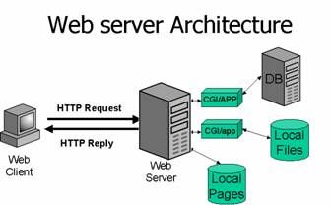
Web Server Architecture Web Server incorporates a modular architecture that supports a variety of APIs and programming technologies that enable you to do the following: Generate dynamic content in response to client requests Modify and extend the behavior of the server Modify the content that is stored in the server
Web Server includes a number of software modules, which are discussed in the following topics in this section:
Content Engines
Server Extensions
Runtime Environments
Application Services

Slide 5
Content Engine
Web Server content engines are designed for manipulating customer data. The following three content engines make up the Web Publishing layer of Web Server architecture:
HTTP (Web Server)
Content Handling
Search
The HTTP engine represents the core of Web Server. The Web Server architecture resides on top of this engine for performance and integration functionality.
The Content Handling engine enables you to manage your server’s content. You can create and store HTML pages, JavaServer Pages, and other files such as graphics, text, sound, or video on your server. When clients connect to your server they can view your files provided they have access.
The Search engine enables Web Server users to search the contents and attributes of documents on the server. As a server administrator, you can create a customized text search interface that works with various types of document formats. Web Server converts many types of non-HTML documents into HTML as it indexes them, so users can use a web browser to view the documents that are found for their search.

Slide 6
Server Extensions
Web Server extensions enable you to extend or replace the function of the server to better suit your business operations. The following server extensions are part of the core Web Server architecture:
Common Gateway Interface (CGI), NetscapeServer Application Programming Interface (NSAPI), Java Servlets and JavaServer Pages (JSP). Common Gateway Interface (CGI) is a stand-alone application development interface that enables you to create programs that process your client requests dynamically.
Application Services
The Web Server architecture includes a set of application services for various application-specific functions. These application services include the following:
Security and access control, Session management service, File system service, Mail service
Runtime Environments
Web Server includes a set of runtime environments that support the server extensions. These runtime environments include the following:
CGI Processor , NSAPI Engine, Java Virtual Machine JVM for the Java platform tool interface.

Slide 7
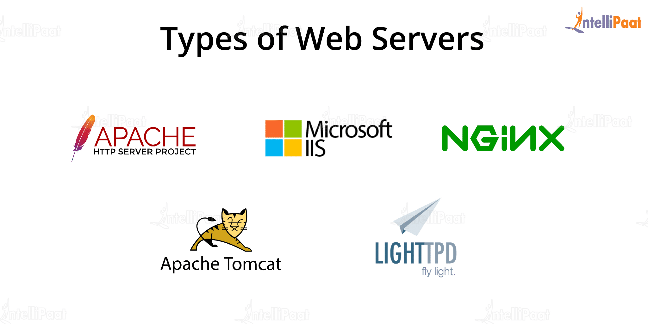
Types of Web Server

Slide 8
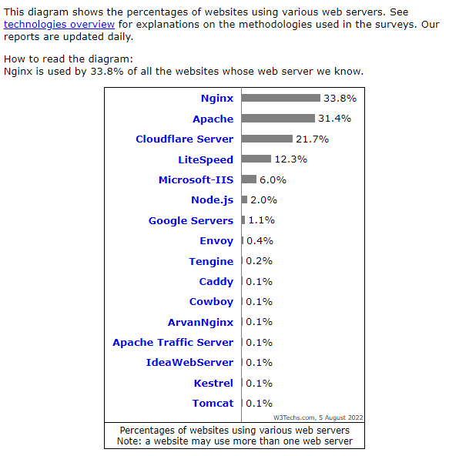
Usage statistics of web servers

Slide 9
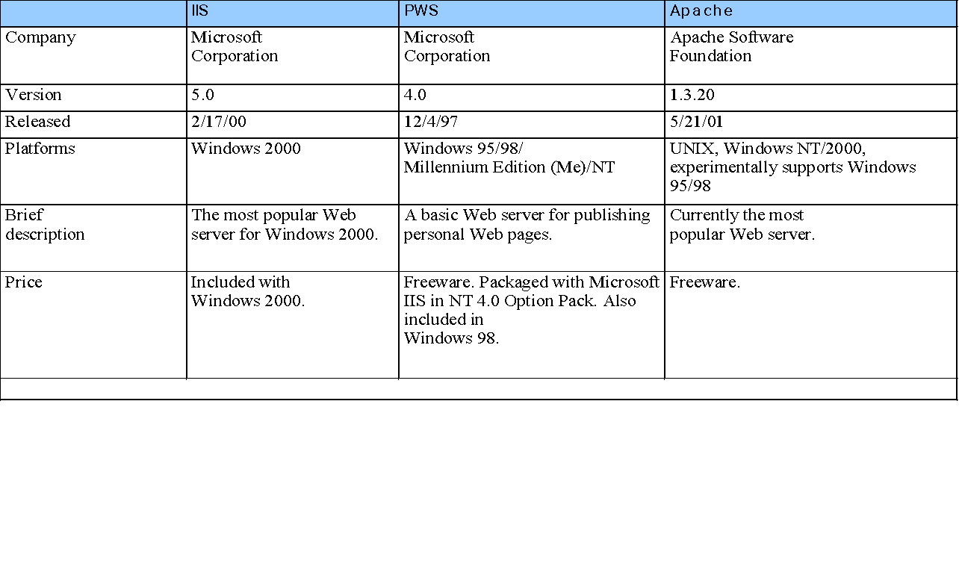
WEB SERVER
‹#›

Slide 10
General Server Characteristics
‹#›
Web servers have two separate directories
The document root is the root directory of all servable documents (well, not really all)
e.g. Suppose the site name is www.bloomers.com and the document root is named topdocs, and it is stored in the /admin/web directory
So, /admin/web/topdocs is the document directory address
If a request URL is:
http://www.bloomers.com/bulbs/tulips.html
The server will search for the file with the given path /admin/web/topdocs/bulbs/tulips.html

Slide 11
GENERAL SERVER CHARACTERISTICS
‹#›
The server root is the root directory for all of the code that implements the server
The server root usually has four files
One is the code for the server itself
Three others are subdirectories
conf - for configuration information
logs - to store what has happened
cgi-bin - for executable scripts
Contemporary servers provide many services:
Virtual hosts - multiple sites on the same system
Proxy servers - to serve documents from the document roots of other sites
Besides HTTP, support for FTP, Gopher, News, email
Support for database access

Slide 12
Sr. No. | Key | Linux | Windows
1 | Open Source | Linux is Open Source and is free to use. | Windows is not open source and is not free to use.
2 | Case sensitivity | Linux file system is case sensitive. | Windows file system is case insensitive.
3 | kernel type | Linux uses monolithic kernel. | Windows uses micro kernel.
4 | Efficiency | Linux is more efficient in operations as compared to Windows. | Windows is less efficient in operations.
5 | Path Seperator | Linux uses forward slash as path seperator between directorioes. | Windows uses backward slash as a path seperator.
6 | Security | Linux is highly secure as compared to Windows. | Windows provides less security as compared to Linux.

Slide 13
Linux is widely used in hacking purpose based systems. | While windows does not provide much efficiency in hacking.
There are 3 types of user account – (1) Regular , (2) Root , (3) Service account | There are 4 types of user account – (1) Administrator , (2) Standard , (3) Child , (4) Guest
Root user is the super user and has all administrative privileges. | Administrator user has all administrative privileges of computers.
Linux file naming convention in case sensitive. Thus, sample and SAMPLE are 2 different files in Linux/Unix operating system. | In Windows, you cannot have 2 files with the same name in the same folder.

Slide 14
References:
Books:
Web Design With HTML, CSS, JavaScript and jQuery Set, 1st Edition, by Jon Duckett.
Hacking Exposed Web Applications, 3rd edition, Joel Scambray, Vincent Liu, Caleb Sima, Released October 2010, Publisher(s): McGraw-Hill
Video Lectures :
1. https://www.youtube.com/watch?v=thJSev60yfg
2. https://intellipaat.com/blog/what-is-a-web-server/
Reference Links:
https://www.tutorialspoint.com/internet_technologies/web_servers.htm
https://www.educba.com/linux-vs-windows-server/

Slide 15

THANK YOU

